Slide 1
Today in LSS – Timed Writing and Professional E-mails
Professional E-mails
End of Class Assessment & Timed Writing Strategy
Final Memo Q & A

Slide 2
Final Memo Q&A
New Page Limit Standards
Other?

Slide 3

Timed – Writing Approach
How to be most efficient

Slide 4
End of Class Assessment
Our final assessment will be Nov. 19.
75 minute time limit
It will be 30% of our final grade.
Closed library
E-mail memo format – CREAC Discussion (i.e., No Question Presented, Brief Answer, Statement of Facts)
This will be the last assessment and class meeting for LSS this semester.

Slide 5
Step 1: Read the Task Memo
IDENTIFY THE FOLLOWING:
Client’s background
Synopsis of your legal problem
Type of document you are drafting
Tone of document (persuasive, objective)-Ours will be objective
To whom you are writing
Scope of your answer

Slide 6
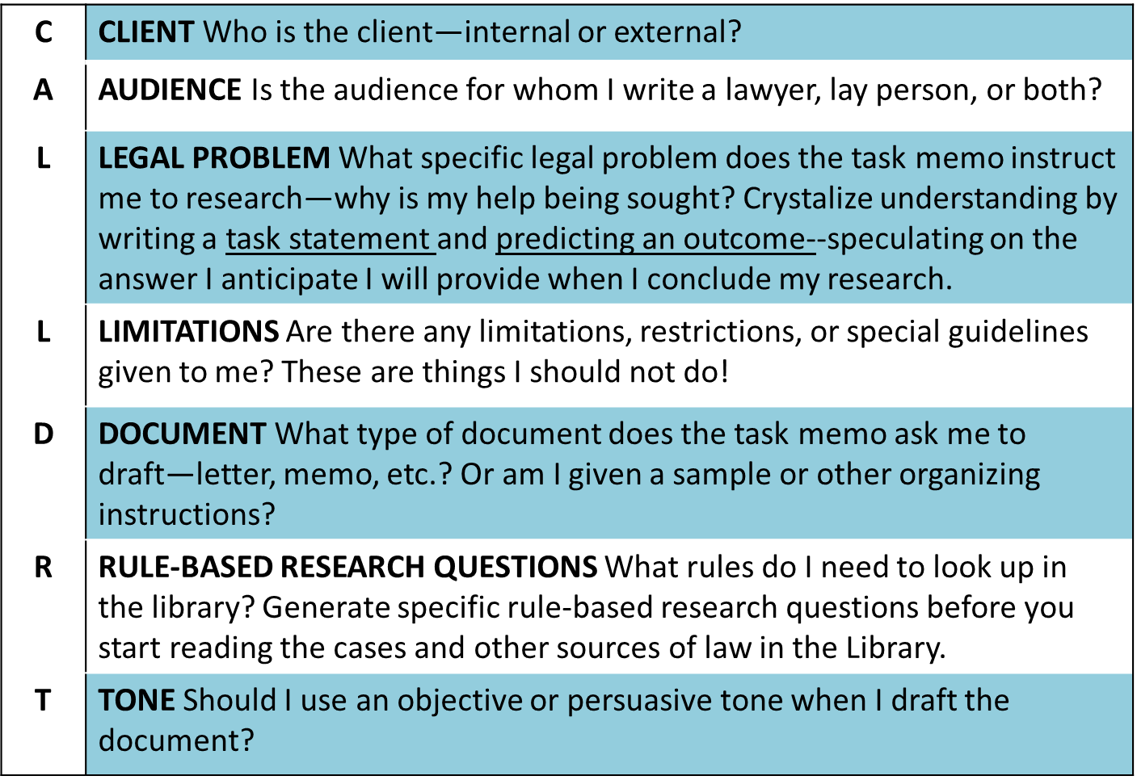
Take 5 minutes and read the task memo!
Notes:
NOTE TO INSTRUCTOR
In this slide we give the students an easy way to remember the items and tasks that they need to complete before moving from the task memo to the library
Review the mnemonic with students.
INFORMATION FOR STUDENTS
It is not necessary recommended that you answer these questions in the CALL-DR-T sequence. This is a way to remember the items you need to find. It will probably be easiest to do your research questions as they come to you or after you have answered all the other questions.
TRANSITION TO NEXT SLIDE
Let’s look at the CALL DR T items

Slide 7
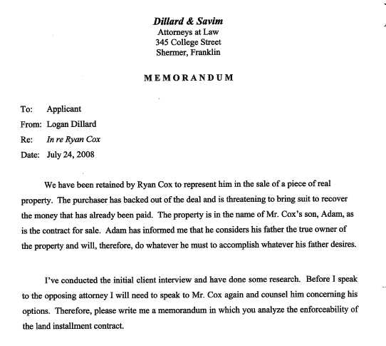
1. Client
Dillard & Savim
Attorneys at Law
345 College Street
Shermer, Franklin
MEMORANDUM
We have been retained by Ryan Cox to represent him in the sale of a piece of real property. The purchaser has backed out of the deal and is threatening to bring suit to recover the money that has already been paid. The property is in the name of Mr. Cox's son, Adam, as is the contract for sale. Adam has informed me that he considers his father the true owner of the property and will, therefore, do whatever he must to accomplish whatever his father desires.
Client
Notes:
NOTE TO INSTRUCTOR
This slide discusses the Client (“C” in CALL DR T)
INFORMATION FOR STUDENTS
Ryan Cox is the client—the MPT is a practical task.
You always have a client even if that client is someone such as your boss who needs your services to prepare something to help an external client.
TRANSITION TO NEXT SLIDE

Slide 8
Document
I've conducted the initial client interview and have done some research. Before I speak to the opposing attorney I will need to speak to Mr. Cox again and counsel him concerning his options. Therefore, please write me a memorandum in which you analyze the enforceability of the land installment contract.
EXAMPLES OF DOCUMENTS
Memo
Brief
Letter
Other
Notes:
NOTE TO INSTRUCTOR
This slide identifies a second TM takeaway, identifying the type of document the student is tasked to create
INFORMATION FOR STUDENTS
It is important to identifying the type of document you are tasked to create.
Here , you are specifically told to write a memorandum
TRANSITION TO NEXT SLIDE

Slide 9
Audience
AUDIENCE
Generally, your audience will be a lawyer or a non-lawyer.
Lawyer For lawyers, you can and should use legal language like “the Statute of Frauds requires a land installment contract be in writing.”
Non-lawyer For laypeople, avoid using legalese. For example, “the law generally requires a contract be in writing” is a perfectly fine translation of the above examples for a layperson.
Lay Person
I've conducted the initial client interview and have done some research. Before I speak to the opposing attorney I will need to speak to Mr. Cox again and counsel him concerning his options. Therefore, please write me a memorandum in which you analyze the enforceability of the land installment contract.
Lawyer
Notes:
NOTE TO INSTRUCTOR
This slide discusses the audience
INFORMATION FOR STUDENTS
This is test of your judgement—can you flexibly adjust your communication and problem solving skills to meet the needs of your audience?
Here, we are writing to our supervisor, who is a lawyer
TRANSITION TO NEXT SLIDE

Slide 10
Tone
TONE
Generally, the tone of your document will be either persuasive or objective.
Objective You will be writing to educate someone on the possible strengths and weaknesses of several options or outcomes.
Persuasive You will be writing to spin the facts so to argue that the strengths of one outcome outweigh the weaknesses of another outcome.
I've conducted the initial client interview and have done some research. Before I speak to the opposing attorney I will need to speak to Mr. Cox again and counsel him concerning his options. Therefore, please write me a memorandum in which you analyze the enforceability of the land installment contract.
Objective
Notes:
NOTE TO INSTRUCTOR
This slide address another grading consideration that is likely to be mentioned/discussed in the task memo—the Tone
INFORMATION FOR STUDENTS
Remember, that sometimes the information to address these considerations will not be explicitly conveyed in the task memo. Instead, you will need to infer the answers to these questions.
Again, your judgement is being tested.
Here, the memorandum is designed to “counsel Mr. Cox” on his options, so we know the tone will be objective
TRANSITION TO NEXT SLIDE

Slide 11
Examples of Tone
“Draft an objective memorandum that analyzes the legal and factual issues related to each of the four Grounds of Relief asserted in Enviroscan’s petition.”
“Please prepare my opinion for the parties consistent with ENE Rule 5-2(c). To be effective the ENE opinion must persuade the parties that it reflects the probable outcome if the case were to proceed through discovery and to trial. An opinion that says “on the one hand this and the other hand that” and that does not reach a conclusion will not lead the parties to appraise their chances realistically and negotiate sensibly.”
Notes:
NOTE TO INSTRUCTOR
We provide students with an example of how tone might be communicated…
INFORMATION FOR STUDENTS
Notice the explicit instruction here, but sometimes the test maker is not this explicit.
TRANSITION TO NEXT SLIDE

Slide 12
Legal Problem
Legal Problem
I've conducted the initial client interview and have done some research. Before I speak to the opposing attorney I will need to speak to Mr. Cox again and counsel him concerning his options. Therefore, please write me a memorandum in which you analyze the enforceability of the land installment contract.
Notes:
NOTE TO INSTRUCTOR
Here, we discuss the most important TM takeaway, the legal problem
INFORMATION FOR STUDENTS
Although this is the fifth item in the mnemonic, it is the most critical takeaway from the TM
To pinpoint your task: As you read the TM, circle or underline verbs and adverbs—look carefully at the verbs in Mr. Dillard’s instructions:
Ask questions:
What problem is the client asking your firm to help him solve?
What did your supervisor tell you to do—what’s your task in solving the client’s problem?
Answer: Write a memo in which you analyze the enforceability of a land installment contract (LIK). Can we find a way to help our client, Mr. Ryan Cox enforce the land installment contract against the purchasers?)
TRANSITION TO NEXT SLIDE

Slide 13
Examples of Legal Problems
“Dr. Harris needs to know the likelihood that the non-compete covenant is enforceable.”
“Draft an objective memorandum that analyzes the legal and factual issues related to each of the four Grounds of Relief asserted in Enviroscan’s petition.”
Notes:
NOTE TO INSTRUCTOR
This slide provides additional examples of other legal problems the student could be asked to answer.
INFORMATION FOR STUDENTS
Notice the test maker has to use a verb to communicate your task. But sometimes to rewrite the task statement to wrap your head around the task.
TRANSITION TO NEXT SLIDE

Slide 14
Examples of Limiting Instructions
“Dr. Harris needs to know the likelihood that the non-compete covenant is enforceable. Please prepare, for my signature, an opinion letter to Dr. Harris in accordance with the firm’s guidelines.”
“Do not deal with Statue of Frauds issues. Another associate is researching that issue.”
“Please prepare my opinion for the parties consistent with ENE Rule 5-2(c). To be effective the ENE opinion must persuade the parties that it reflects the probable outcome if the case were to proceed through discovery and to trial. An opinion that says “on the one hand this and the other hand that” and that does not reach a conclusion will not lead the parties to appraise their chances realistically and negotiate sensibly.”
Notes:
NOTE TO INSTRUCTOR
This slide provides examples of limiting instructions.
INFORMATION FOR STUDENTS
We will show you more explicit limiting instructions in other MPTs
Sometimes the examiners say: Do not concern yourself with… or other members of the team are working on…
The point is more is needed to provide a comprehensive solution, but others are working on it or though you might think something is relevant, that something is beyond the scope of your assignment…
TRANSITION TO NEXT SLIDE

Slide 15
You have read the task memo, now begin
Draft the head of your document (i.e. e-mail caption)
Outline your necessary parts (as you know them thus far)

Slide 16

Step 2: Go to the Library
(Yes, skip the client file)
Read the cases first
  Read the last paragraphs frequently have a case summary and holding.
  Then go back and look at the beginning. Facts will likely be important!
  Don’t skip footnotes

Slide 17

MPT – Library Continued
Then, read statutory materials
  How does this connect to your case? The cases you read?
Extract (highlight) the rules from the materials
  Be sure you can explain.
  Add them to the outline. Even if you have to cut and paste later.
  Crib!
Finalize the outline

Slide 18

Step 3: the client file Strikes Back!
Return to the Task Memo and the factual information that follows.
Identify the RELEVANT facts from your client’s case.
  Note: compare and distinguish accordingly

Slide 19
BLW – Exercise 1.2
Legal Question – Who could Mr. Lillo bring a claim against for compensation for his injuries suffered in tripping on the sidewalk in front of Ms. Holmes home?
Read Section 7-210 of the City of New York Administrative Code and the excerpt of Schwartz v. Pezzolanti
How would you structure this answer if received a problem like this in a timed writing?
How would you write the rule from 7-210 of the City of New York Administrative Code?

Slide 20
Homework
Final Memo due Sunday 11/8 at 5:00 p.m. in Canvas
Remember class on Tuesday 11/10 is in 102B from 9-10:15 a.m.
Early next week, I will assign a timed writing practice e-mail to be done under timed conditions prior to 11/12 class. We will walk through the problem together on 11/12.

